Slide 1
Osmóza A VYUŽITÍ KOLEM NÁS
21. 11. 2022

Slide 2
OsmOTICKÝ Tlak
Na přechod rozpouštědla mezi roztoky můžeme nahlížet jako na chemickou reakci (dochází k vyrovnávání chemického potenciálu)
Pro bilanci rozpouštědla platí
Pro rozpuštěnou látku platí
Pro odpovídající koncentrace (předpokládejme čisté rozpouštědlo v jedné z částí)

Slide 3


OsmOTICKÝ Tlak
Podmínka pro rozpouštědlo ve stavu rovnováhy
$$\log{c_{0} − \log{c_{0}^{´ }= −\frac{μ_{0}\left(T,P\right)}{RT} +\frac{μ_{0}\left(T,P+∆P\right)}{RT}}}$$
Pro slabé roztoky použijeme rozvoj do prvního řádu
$$\log{c_{0}^{´} = \log\left(1 − c_{1}^{´}\right) ≈} − c_{1}^{´} ,$$
$μ_{0} \left(T,P+∆P\right)$= $μ_{0} \left(T,P\right) +\left(\frac{∂μ_{0}}{∂P}\right)∆P$
Výsledně
Osmotický tlak je roven tlaku ideálního plynu o látkovém množství rovném množství rozpuštěné látky v objemu, ve kterém je rozpuštěno.
$$P_{osm }=∆P= c_{1}^{´}\frac{R T}{\left(\frac{∂μ_{0}}{∂P}\right)} ≈n_{1}^{´}\frac{R T}{n_{0}^{´}v_{0}}$$

Slide 4
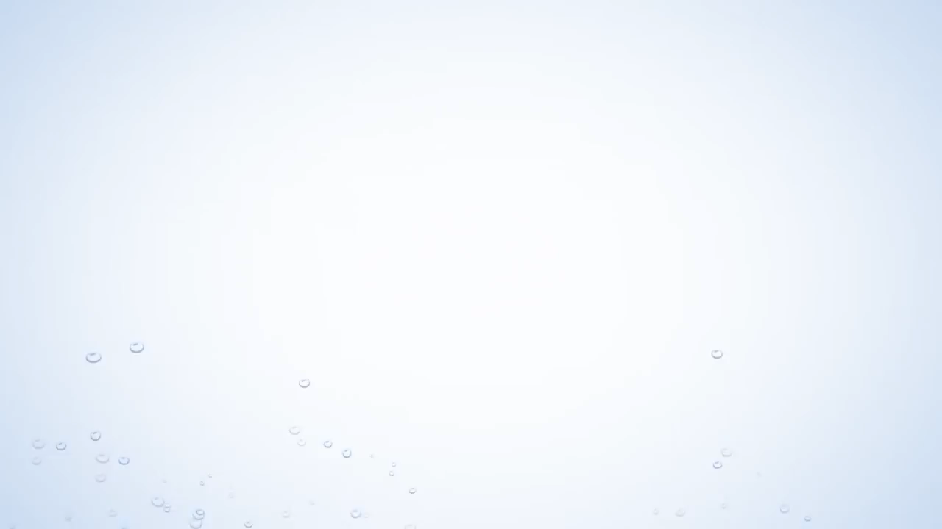
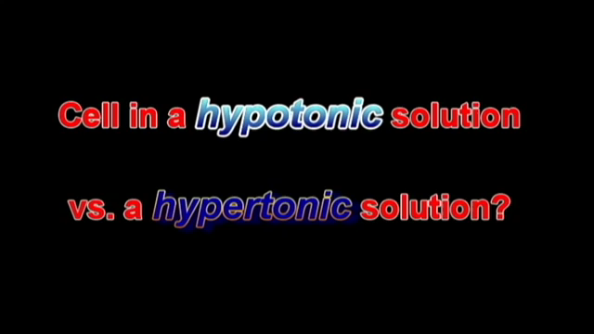

Slide 5
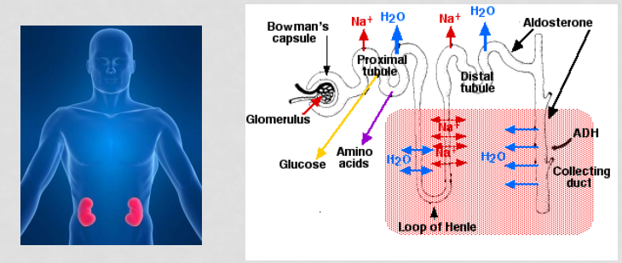
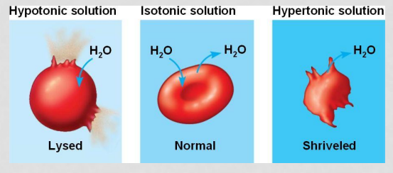
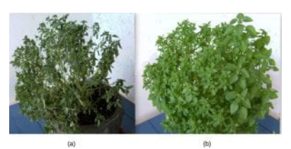
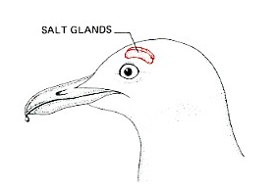
Důsledky A VYUŽITÍ
Celá živá příroda

Slide 6

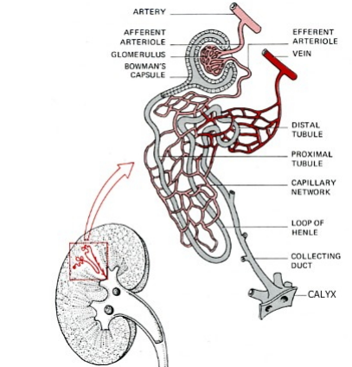
LEDVINY
The nephron makes urine by filtering the blood of its small molecules and ions and then reclaiming the needed amounts of useful materials. Surplus or waste molecules and ions are left to flow out as urine. In 24 hours the kidneys reclaim ~1,300 g of NaCl ~400 g NaHCO3 ~180 g glucose almost all of the 180 liters of water that entered the tubules.
The steps:
  Blood enters the glomerulus under pressure.
  This causes water, small molecules (but not macromolecules like proteins) and ions to filter through the capillary walls into the Bowman's capsule. This fluid is called nephric filtrate. As the table shows, it is simply blood plasma minus almost all of the plasma proteins. Essentially it is no different from interstitial fluid.
https://www.biology-pages.info/K/Kidney.html

Slide 7
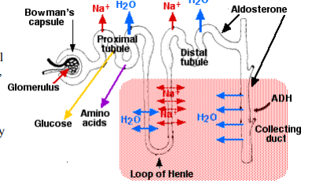
LEDVINY
Nephric filtrate collects within the Bowman's capsule and then flows into the proximal tubule.
Here more than 90% of the glucose and all of the amino acids, >90% of the uric acid, and ~60% of inorganic salts are reabsorbed by active transport.
The active transport of Na+ out of the proximal tubule is controlled by angiotensin II. The active transport of phosphate (PO4 3- ) back into the blood is regulated (suppressed) by both the parathyroid hormone and fibroblast growth factor 23 (FGF-23).
As these solutes are removed from the nephric filtrate, a large volume of the water follows them by osmosis (80–85% of the 180 liters deposited in the Bowman's capsules in 24 hours).
As the fluid flows into the descending segment of the loop of Henle, water continues to leave by osmosis because the interstitial fluid is very hypertonic. This is caused by the active transport of Na+ out of the tubular fluid as it moves up the ascending segment of the loop of Henle.
In the distal tubules, more sodium is reclaimed by active transport, and still more water follows by osmosis.
Final adjustment of the sodium and water content of the body occurs in the collecting ducts.

Slide 8
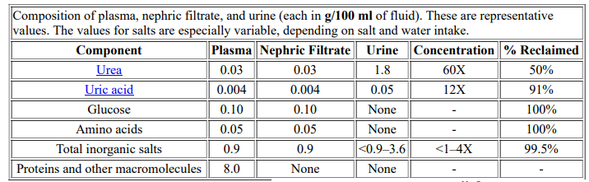
Ledviny – tvorba MOČI

Slide 9
Ledviny – DALŠÍ FUNKCE
SODÍK
Although 97% of the sodium has already been removed, it is the last 3% that determines the final balance of sodium — and hence water content and blood pressure — in the body. The reabsorption of sodium in the distal tubule and the collecting ducts is closely regulated by the synergistic action of the hormones vasopressin and aldosterone.
VODA
  The hypertonic interstitial fluid surrounding the collecting ducts provides a high osmotic pressure for the removal of water.
  Transmembrane channels made of proteins called aquaporins are inserted in the plasma membrane greatly increasing its permeability to water. (When open, an aquaporin channel allows 3 billion molecules of water to pass through each second.)
  Insertion of aquaporin-2 channels requires signaling by vasopressin. It is also known as arginine vasopressin (AVP), the antidiuretic hormone (ADH), and vasotocin (VT).
    Vasopressin binds to receptors (called V2 receptors) on the basolateral surface of the cells of the collecting ducts.
    Binding of the hormone triggers a rising level of cAMP within the cell. This "second messenger" initiates a chain of events culminating in the insertion of aquaporin2 channels in the apical surface of the cell.

Slide 10

VODA II
The release of vasopressin (from the posterior lobe of the pituitary gland) is regulated by the osmotic pressure of the blood. Anything that dehydrates the body, such as perspiring heavily, increases the osmotic pressure of the blood; turns on the vasopressin → V2 receptors → aquaporin-2 pathway.
The result:
  As little as 0.5 liter/day of urine may remain of the original 180 liters/day of nephric filtrate.
  The concentration of salts in the urine can be as much as four times that of the blood. (But not high enough to enable humans to benefit from drinking sea water, which is saltier still
  If the blood should become too dilute (as would occur after drinking a large amount of water), Vasopressin secretion is inhibited. The aquaporin-2 channels are taken back into the cell by endocytosis. The result: a large volume of watery urine is formed (with a salt concentration as little as one fourth of that of the blood).

Slide 11
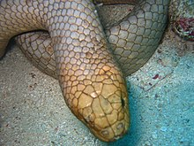
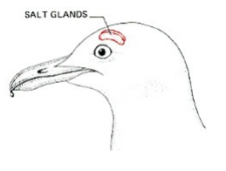
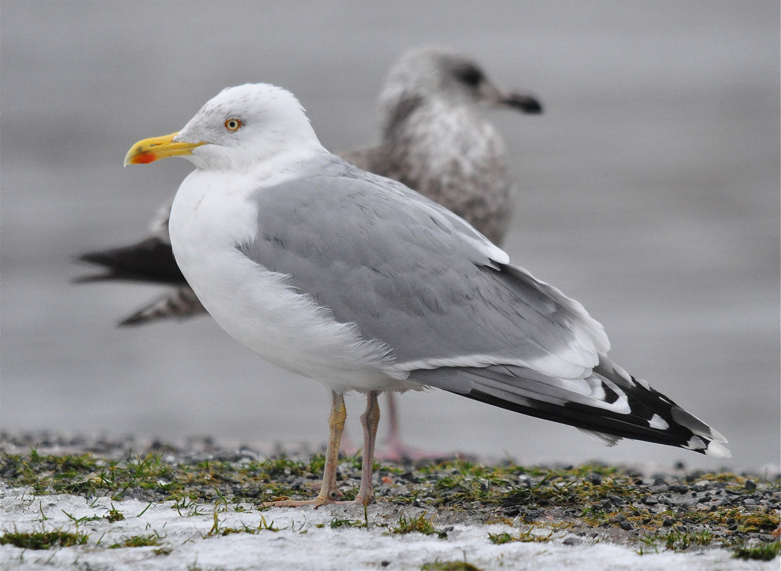
MOŘSKÉ Ptactvo
Marine birds, which may pass long periods of time away from fresh water, and sea turtles use a similar device. They, too, drink salt water to take care of their water needs and use metabolic energy to desalt it. In the herring gull, shown here, the salt is extracted by two glands in the head and released (in a very concentrated solution — it is saltier than the blood) to the outside through the nostrils. Marine snakes use a similar desalting mechanism.

Slide 12
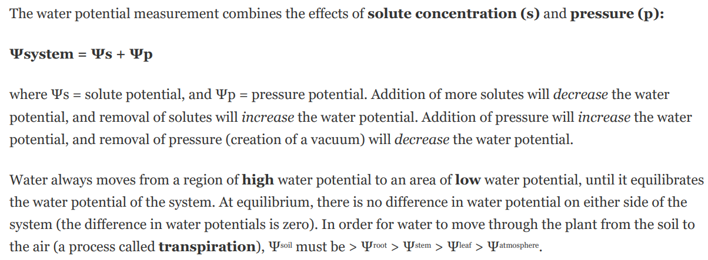
STROMY – DVA PŘÍSPĚVKY
Xylém (také dřevní cévní svazek nebo dřevo) je botanické označení pro druh pletiva cévnatých rostlin, které přivádí a rozvádí minerální živiny z kořenové soustavy rostliny směrem nahoru do jejích nadzemních částí. Výraz „xylém“ je odvozen ze starořeckého slova xúlon, což znamená „dřevo“. Xylém může mít v rostlině funkci mechanickou (opora), transportní (rozvod živin) a zásobní. Živiny se pohybují uvnitř xylému na základě tzv. kořenového vztlaku.

Slide 13
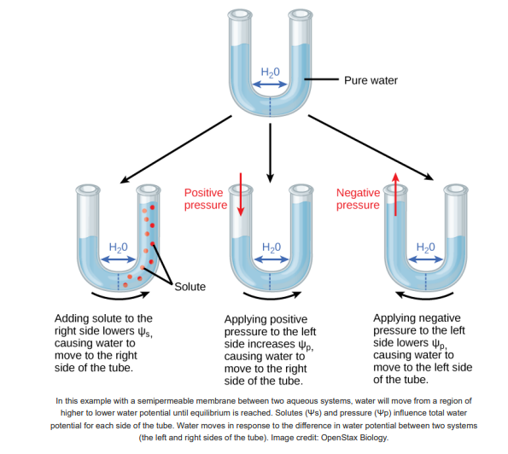
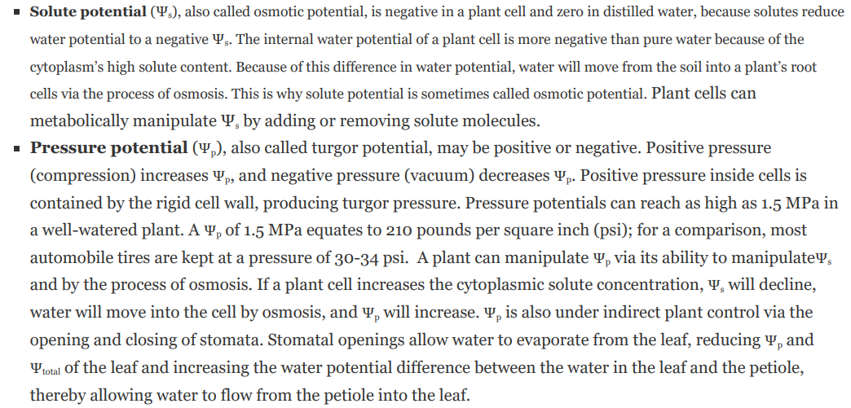
STROMY – DVA PŘÍSPĚVKY

Slide 14
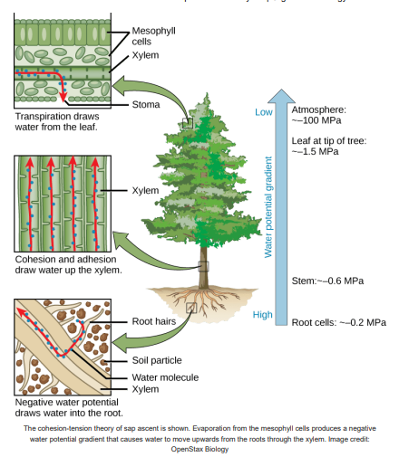
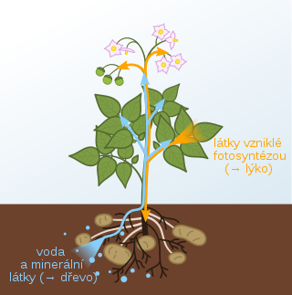
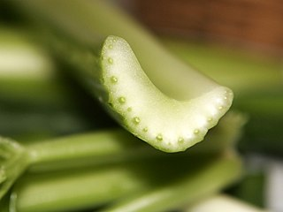
TRANSPORT VODY V ROSTLINĚ
1. Root pressure pushes water up
2. Capillary action draws water up within the xylem
3. Cohesion-tension pulls water up the xylem
Root pressure relies on positive pressure that forms in the roots as water moves into the roots from the soil. Water moves into the roots from the soil by osmosis, due to the low solute potential in the roots (lower Ψs in roots than in soil). This intake o f water in the roots increases Ψp in the root xylem, driving water up. In extreme circumstances, root pressure results in guttation, or secretion of water droplets from stomata in the leaves. However, root pressure can only move water against gravity by a few meters, so it is not strong enough to move water up the height of a tall tree.
Capillary action or capillarity is the tendency of a liquid to move up against gravity when confined within a narrow tube (capillary). Capillarity occurs due to three properties of water:
  1. Surface tension, which occurs because hydrogen bonding between water molecules is stronger at the air-water interface than among molecules within the water.
  2. Adhesion, which is molecular attraction between “unlike” molecules. In the case of xylem, adhesion occurs between water molecules and the molecules of the xylem cell walls.
  3. Cohesion, which is molecular attraction between “like” molecules. In water, cohesion occurs due to hydrogen bonding between water molecules.

Slide 15
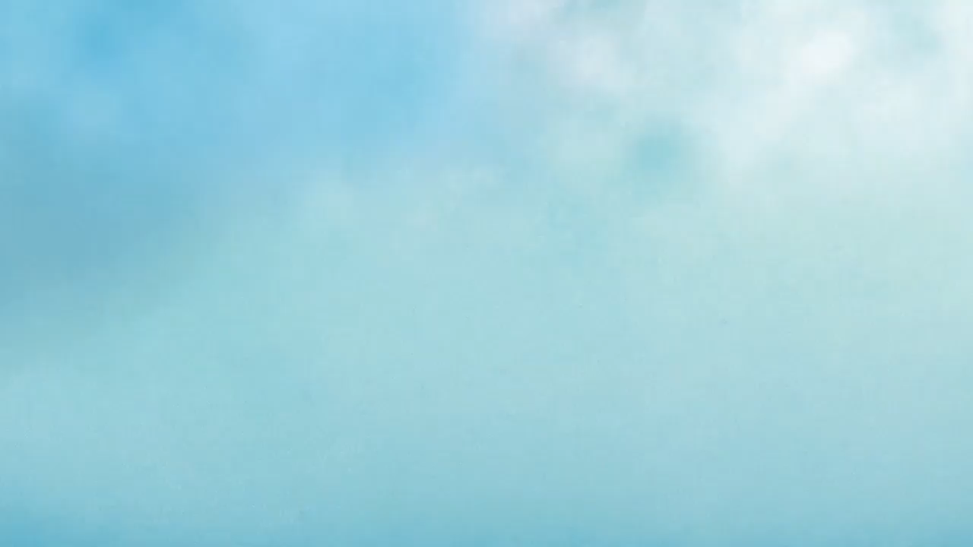
TRANSPORT VODY V ROSTLINĚ
The cohesion-tension hypothesis is the most widely-accepted model for movement of water in vascular plants. Cohesion-tension essentially combines the process of capillary action with transpiration, or the evaporation of water from the plant stomata. Transpiration is ultimately the main driver of water movement in xylem. The cohesion-tension model works like this:
1. Transpiration (evaporation) occurs because stomata are open to allow gas exchange for photosynthesis. As transpiration occurs, it deepens the meniscus of water in the leaf, creating negative pressure (also called tension or suction).
2. The tension created by transpiration “pulls” water in the plant xylem, drawing the water upward in much the same way that you draw water upward when you suck on a straw.
3. Cohesion (water sticking to each other) causes more water molecules to fill the gap in the xylem as the top-most water is pulled toward the stomata.

Slide 16



Tepelné VJEMY

Slide 17
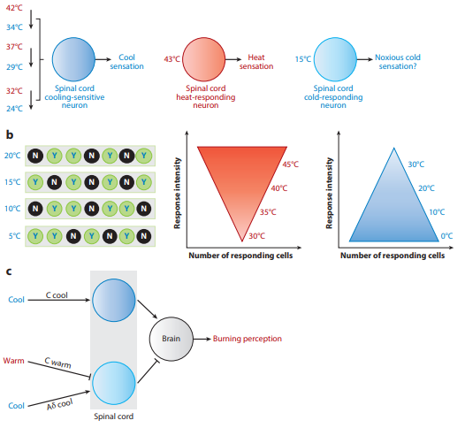
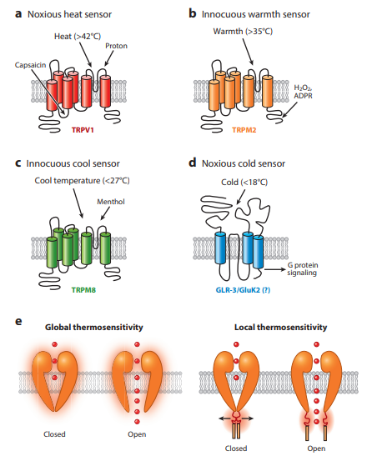
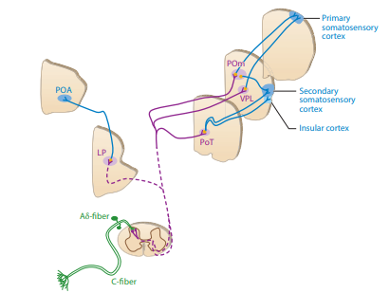
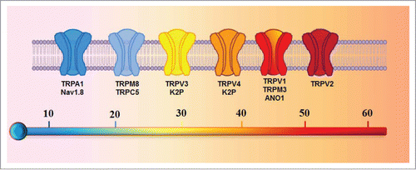
POCIT TEPLA A CHLADU

Slide 18
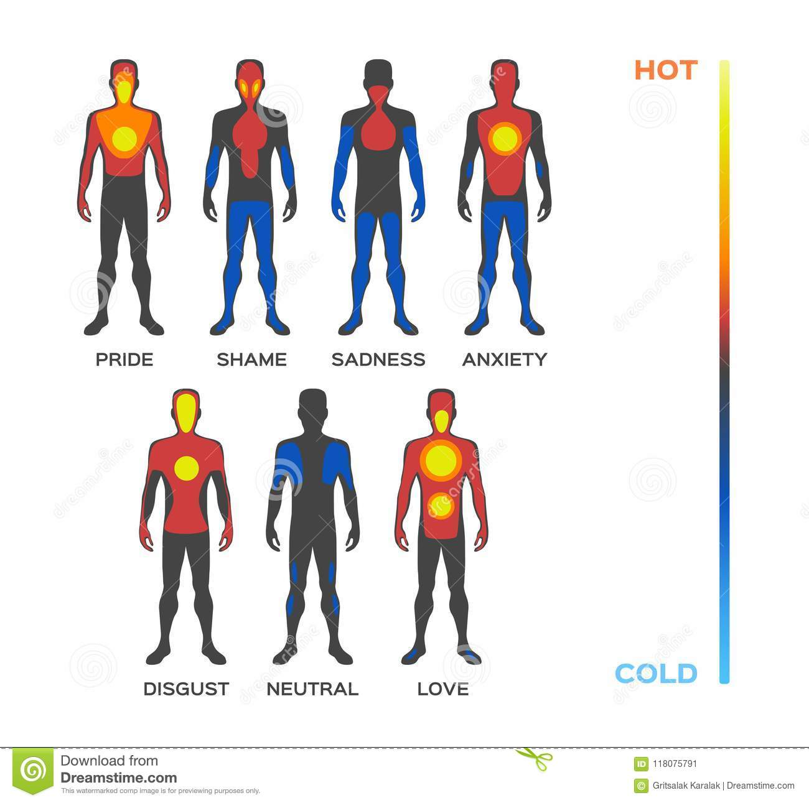
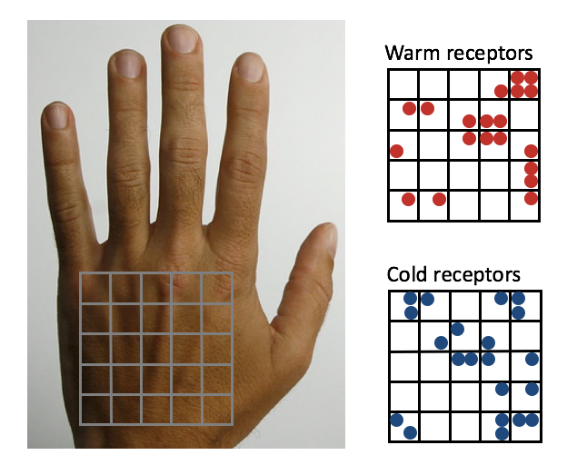
POCIT TEPLA A CHLADU
7 cold spots and 0.24 warm spots per 100 mm2
Cold signal -- 10-20 m/s, warm signal 1-2 m/s

